Slide 1


How to get my paper published?
Presented by: Nadia Rosenthal, Editor-in-Chief, Differentiation

Slide 2
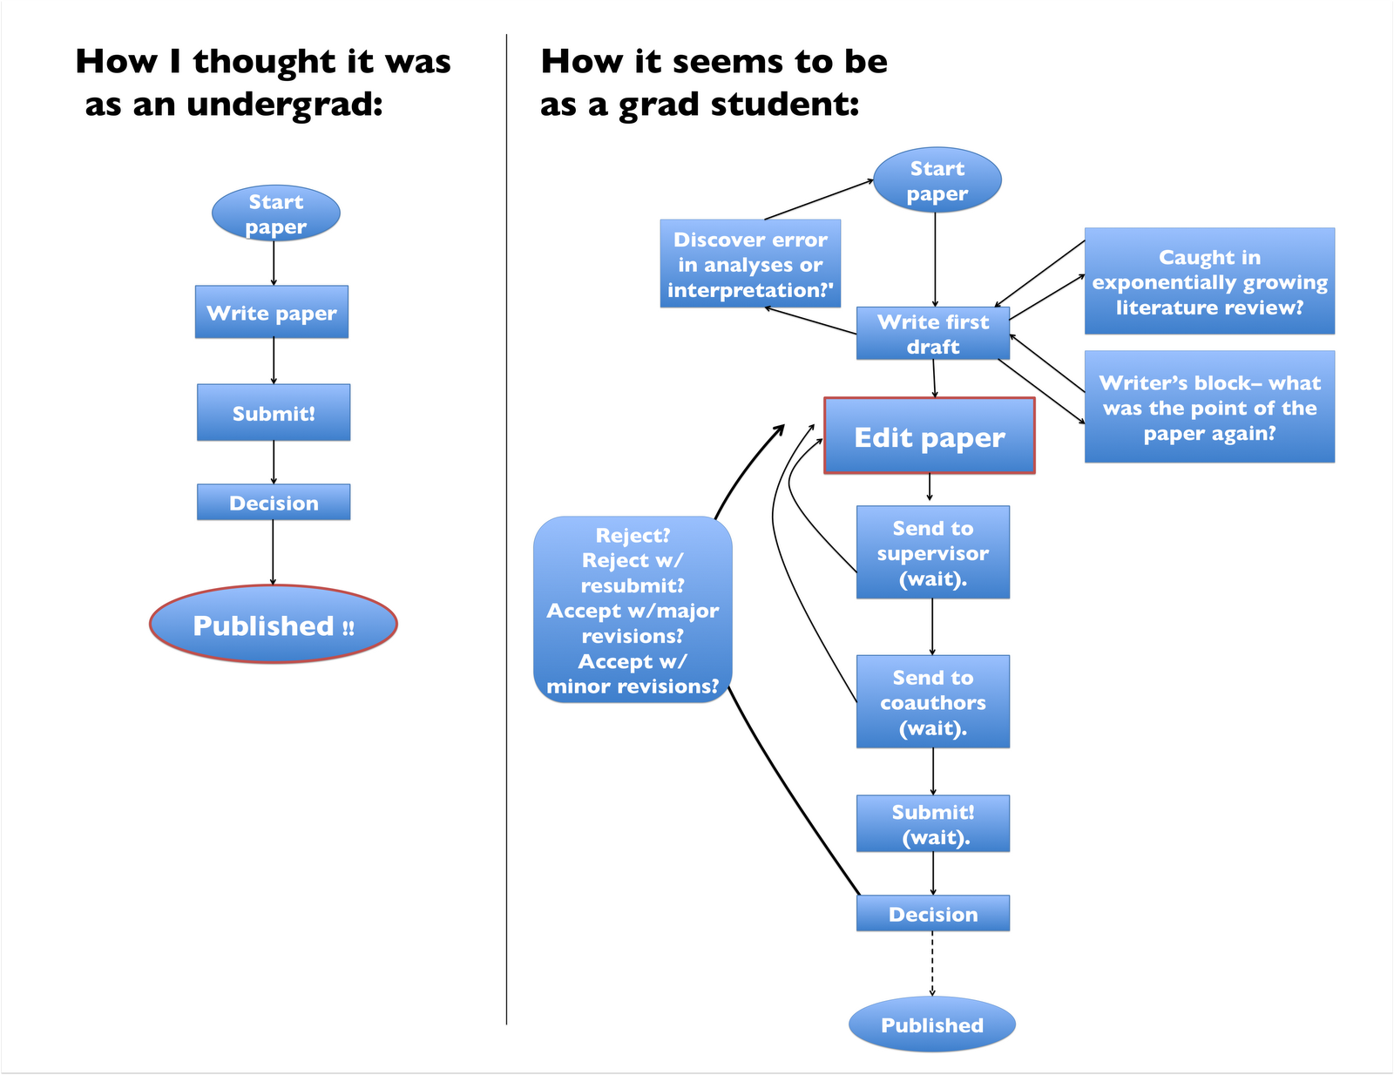
How to publish a paper

Slide 3
What makes a good paper? Groundwork
The most fundamental ingredient is excellent research.
Work with the best scientists you can, in the best lab you can find, so you are surrounded by excellence during your training.
Make sure that the questions you investigate are important and of interest to others in the field.
The most successful papers are those that present innovative research. But the best papers also present their story in a clear and logical way. The thinking behind the paper is clear, so the writing is clear.
Writing good research papers can require a bit of strategic thinking, practice, and a lot of know-how. Practice makes perfect.

Slide 4
Groundwork: is your story convincing?
The reader must come to the same conclusions you have solely on the basis of your results. So ask yourself whether the reader will be led to the correct overall conclusion.
What convincing experiment might be missing? Are there alternative explanations?
If so, what data will you need to collect to eliminate those alternate possibilities? Before performing a new experiment, always ask yourself how it will contribute to the logic of the publication.
Test your reasoning on colleagues by asking them whether you told a logical and convincing story after giving a talk from your assembled figures.

Slide 5
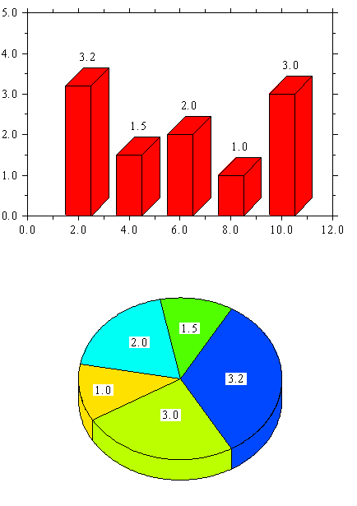
Groundwork: think in Figures
Judge when you have enough data to write a paper: write too soon, and you may be wasting your time. Wait too long, and you risk getting scooped.
Stop and write when the data are sufficient to tell a story that is complete and makes sense.
The key is to constantly keep the paper in mind while you are performing the experiments.
Think about the figures that can already go into the paper and the information they will contain.

Slide 6
Frequent mistakes in preparing a paper
The Abstract
1. Abstract results, methods or conclusion are not the same as the reported results.
2. Exceeds the word limit allowed by the journal.
3. It is formatted incorrectly for the journal (eg. unstructured versus structured).
4. The general interest of the work is not emphasized.
Advice from Christine Mummery, ISD President:
Look for the “seed of brilliance”. The Editor-in-Chief will look at your work first, and decide whether it should be sent out to the other Editors for review. Make sure your Abstract captures the novel aspects of your work.

Slide 7
Frequent mistakes in preparing a paper
The Introduction
1. Does not describe the purpose and objective of the study.
2. Does not mention the importance and originality of the study.
3. Contains material unrelated to the study.
4. Contains material belonging in other sections of the manuscript.
5. It is not interesting.
Advice from Christine Mummery, ISD President:
The Kiss Principle; Keep It Short and Simple. Even if the journal is for a scientific audience, use simple language to explain complex ideas.

Slide 8
Frequent mistakes in preparing a paper
The Methods
1. Some methods reported are not used.
2. Some methods are missing, thus not allowing duplication of the study.
3. Reports statistical methods incorrectly or poorly.
4. Described methods do not relate to the results.
The Results
1. Reports data incompletely.
2. Contains results from another study.
3. Information repeats what is shown in tables and figures.
4. Includes discussion or methods.

Slide 9
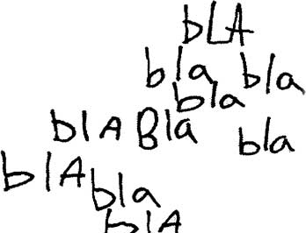
Frequent mistakes in preparing a paper
The Discussion
1. It is biased and omits findings from other studies.
2. Does not explain key results.
3. Does not describe the limitations of the study.
4. Does not acknowledge speculative aspects.
5. Includes information unrelated to the study.
6. Includes outdated references or misrepresents them.
7. Overstates the importance of the study.
8. Too expansive and lacks a logical flow.

Slide 10
Frequent mistakes in preparing a paper
The Conclusion
1. Just restates the content from other sections of the manuscript.
2. Includes statements not supported by the study.
3. Does not clearly relate the findings to the purpose of the study.
4. Contains unnecessary information.
TIP: If English is not your first language, seek help from a native English speaker to proofread your manuscript BEFORE you submit it. Reviewers will be discouraged by poor English. Editors don’t have time to proof language. Publishers don’t always provide this service.

Slide 11
Helping the review process
Submitting the paper:
You can help the review process go smoothly by providing a cover letter that includes, in very clear language, a concise version of the whole logic of the paper.
If there are any special considerations that the editor and reviewers should take into account, include these in the cover letter.
The journal is interested! Responding to reviews:
Make the assumption that the reviewers are offering their suggestions as constructive criticism.
Make all possible attempts to comply with their requests, including performing extra experiments, even if you think they are unnecessary.

Slide 12
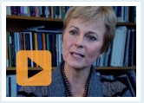

Further tips
www.biggerbrains.com

Slide 13
Choosing an appropriate journal
Aiming your paper at the most appropriate journal can save much effort and reveal your results to the world sooner.
It may be tempting to send your paper to a top journal even if your results are not groundbreaking, but you can save time and reduce your frustration if you send it to the appropriate journal first, instead of waiting until it's rejected by a top journal.
The so-called top journals value novelty and unexpected findings, but other journals may be more interested in careful, extensive analyses of critical processes.
Journals with Editors who are professional scientists are more likely to see the merit in your study even if it’s imperfectly presented or incomplete, and can help you improve it.

Slide 14
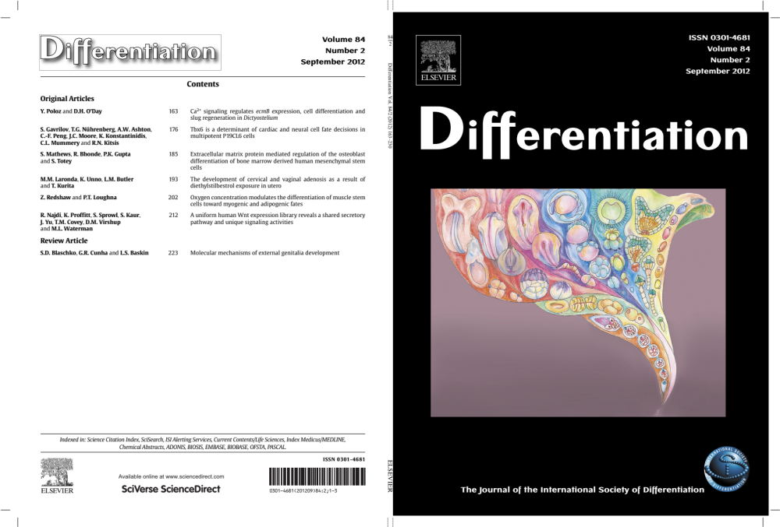
What are we looking for in Differentiation?
Differentiation is a multidisciplinary journal covering topics related to:
cell differentiation
development
cellular structure and function
cancer
Differentiation of eukaryotes at the molecular level and the use of transgenic and targeted mutagenic approaches to problems of differentiation are of particular interest to the journal.

Slide 15
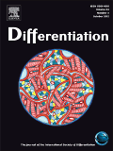
What are we looking for in Differentiation?
Specific topics:
Embryonic patterning and organogenesis
Mechanisms of cell lineage commitment
Tissue homeostasis
Establishment of cellular polarity
Stem cell differentiation
Cell reprogramming mechanisms
Stability of the differentiated state
Cell and tissue interactions in vivo and in vitro
Signal transduction pathways in development and differentiation
Carcinogenesis and cancer
Mechanisms of cell growth and division especially relating to cancer
Differentiation in regeneration and ageing

Slide 16
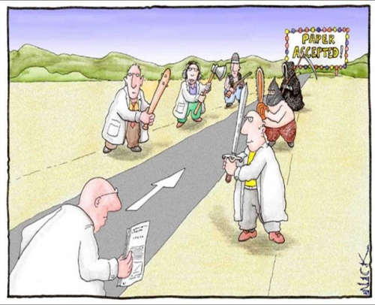
Consider sending your next paper to Differentiation…and avoid this!
A

